Slide 1









AI
Features
CTTL Tech Workshops, Fall 2025

Slide 2




01
Recognize the AI features currently available in Canvas and their instructional uses.
02
Practice using at least one AI tool in Canvas
By the end of this session, you will:
Apply recommended best practices to integrate AI into their courses responsibly.
03

Slide 3

What is Canvas AI ?

Slide 4


Overview of Canvas AI Features
1
2
3
4
Translations
Discussion Summaries
& Insights
Rubrics
Smart Search

Slide 5
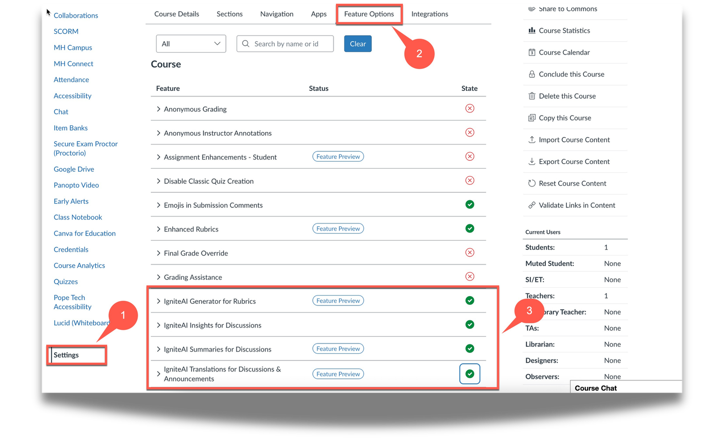
How to Enable Canvas AI Features
    All AI features in Canvas are off
    by default.
    You must enable them in
    Course Settings → Feature Options

Slide 6
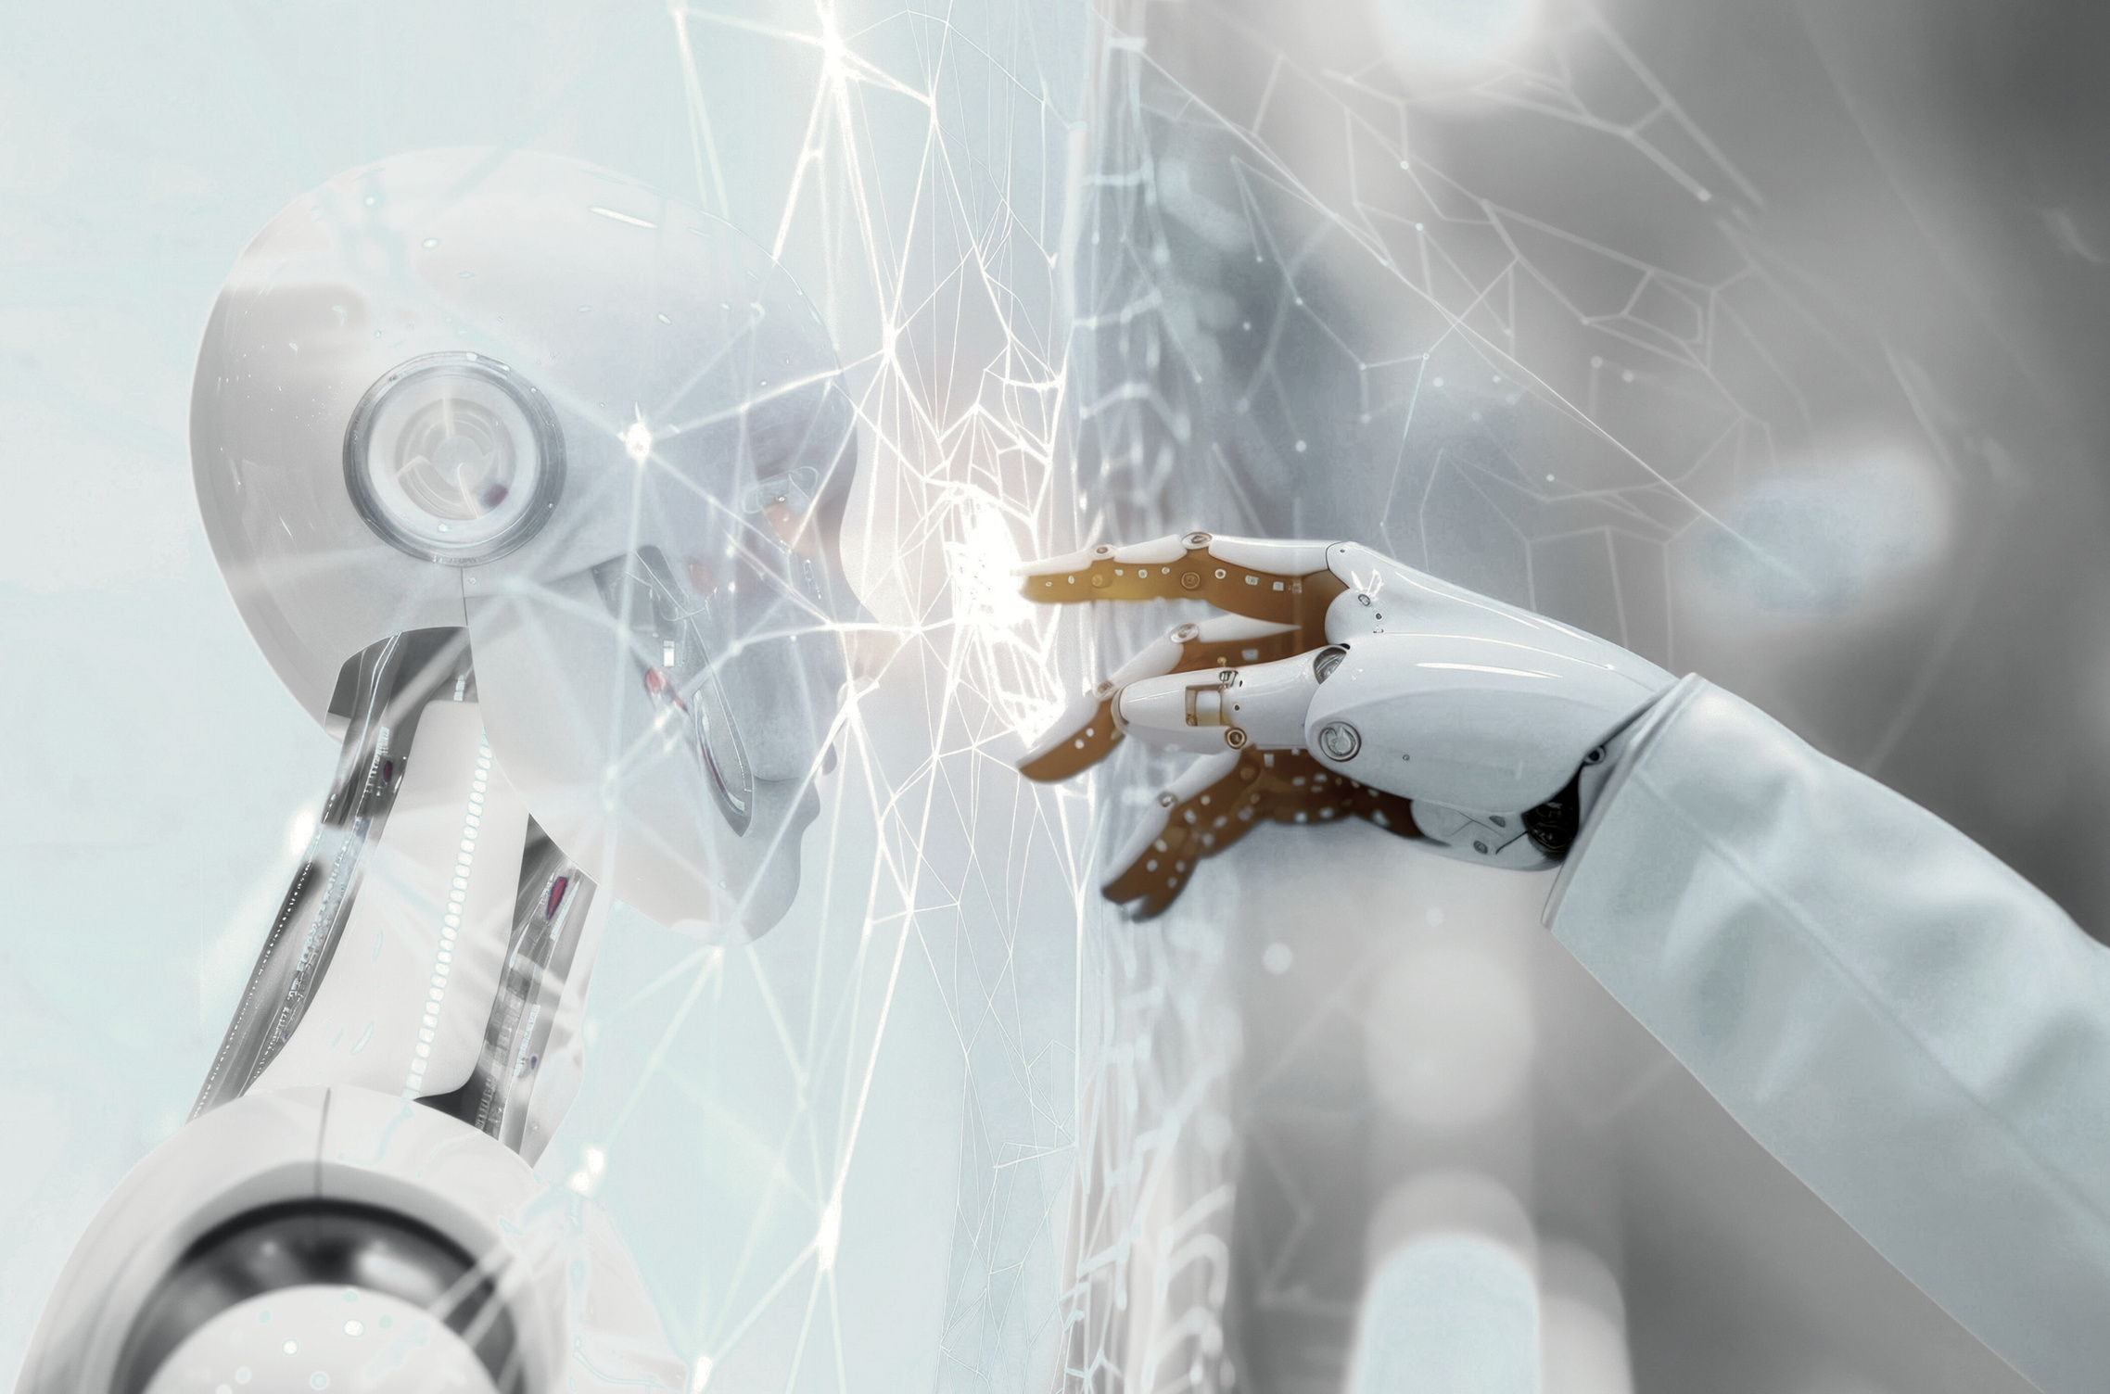
AI
Features
1
Translations

Slide 7
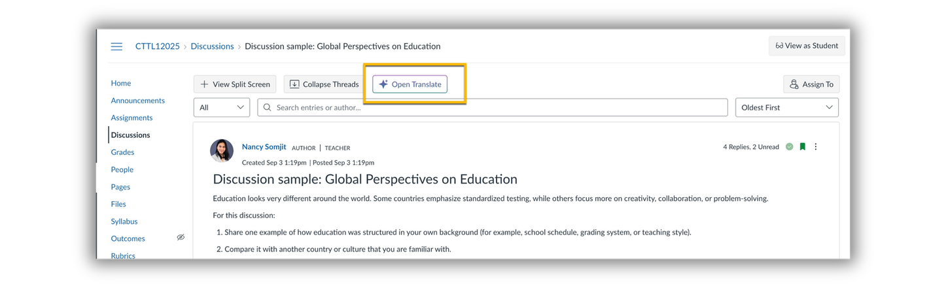
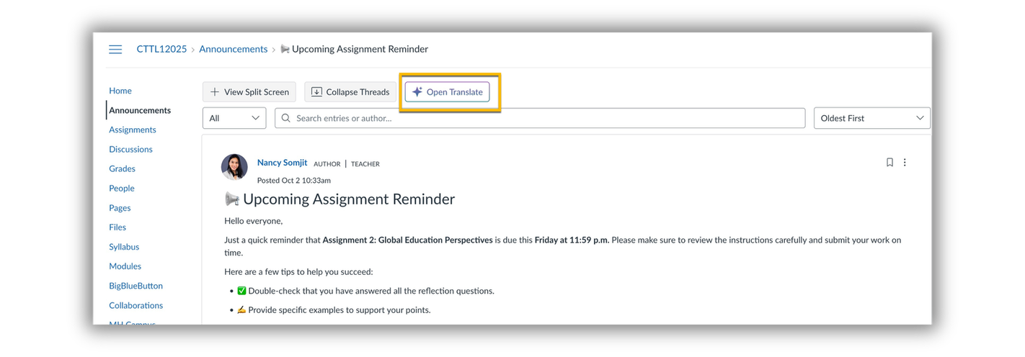
Translation Feature
1
⚙️ Important Notes
    AI translation currently limited to discussions and announcements.

Slide 8
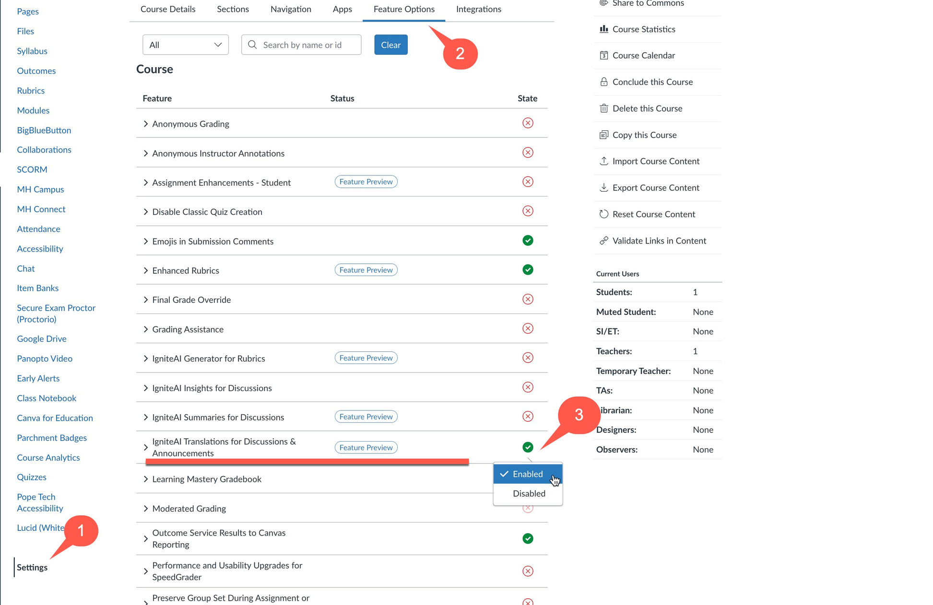

Slide 9
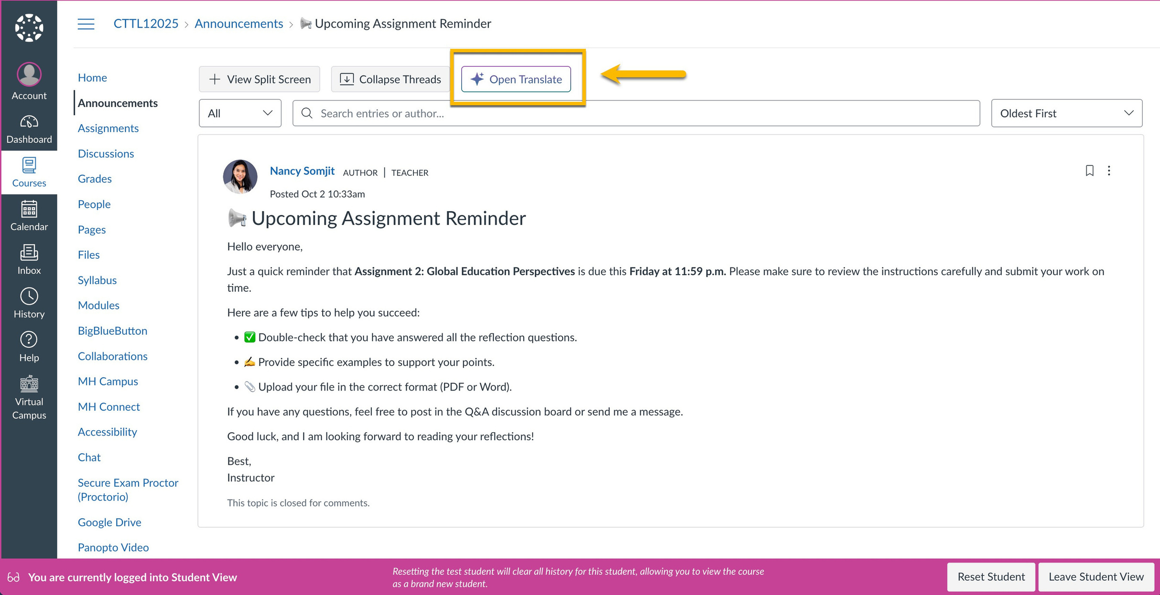

Slide 10
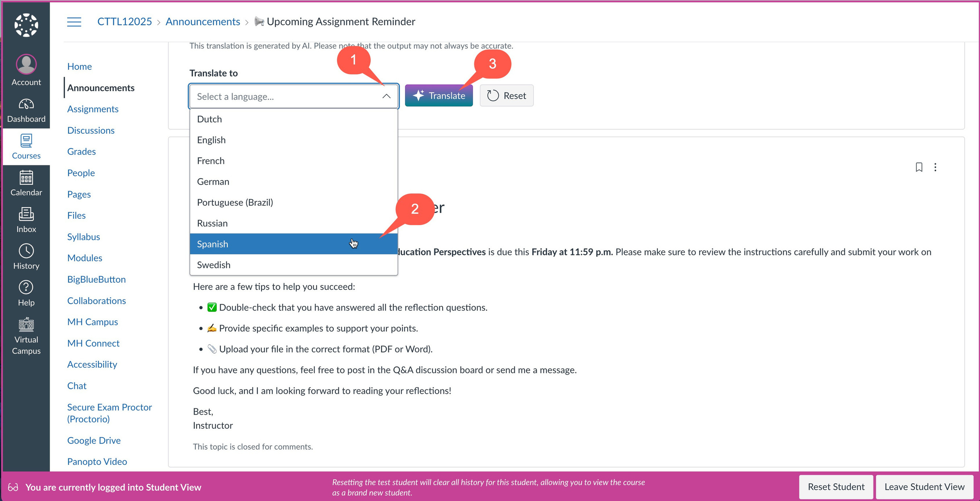

Slide 11
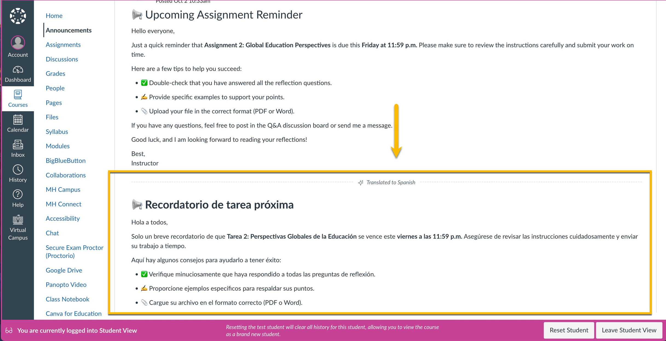

Slide 12
AI
Features
2
Discussion Summaries & Insights

Slide 13
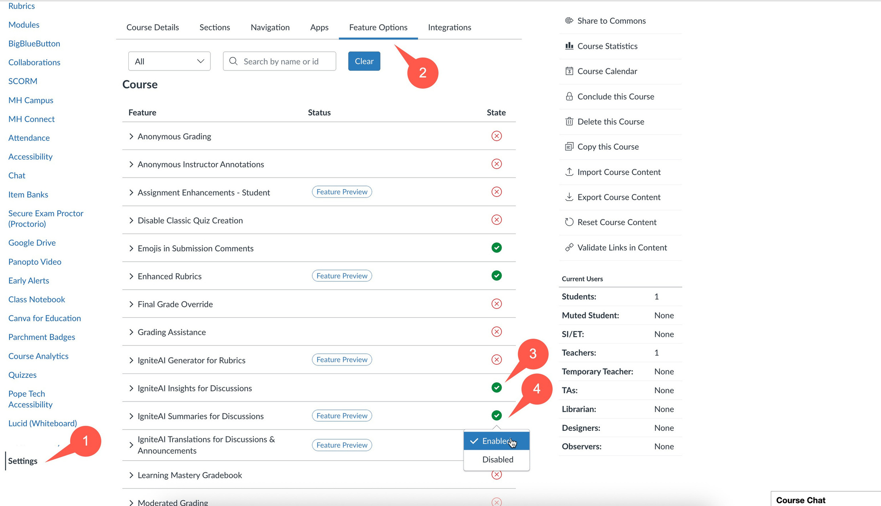

Slide 14
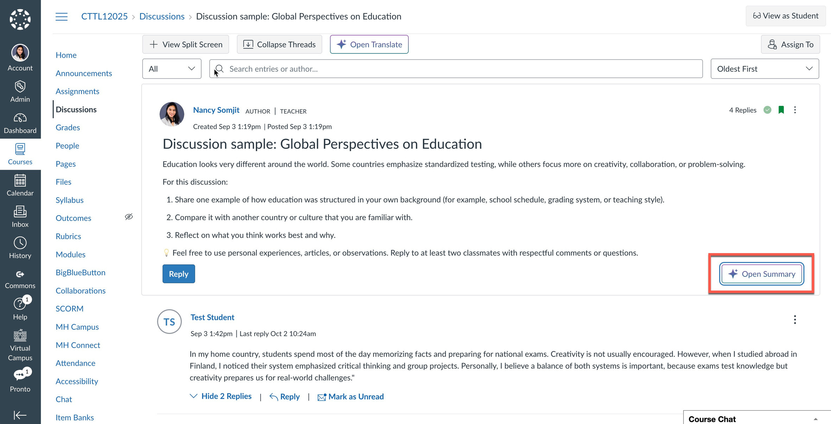

Slide 15
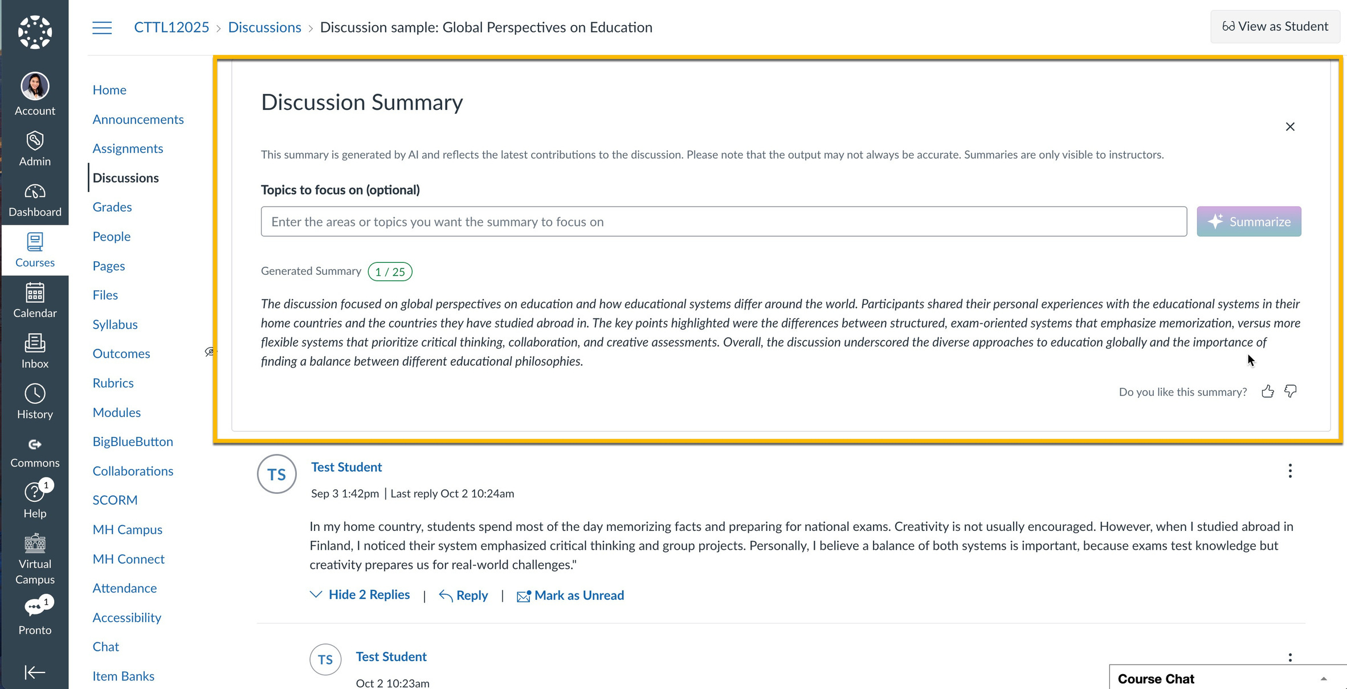

Slide 16
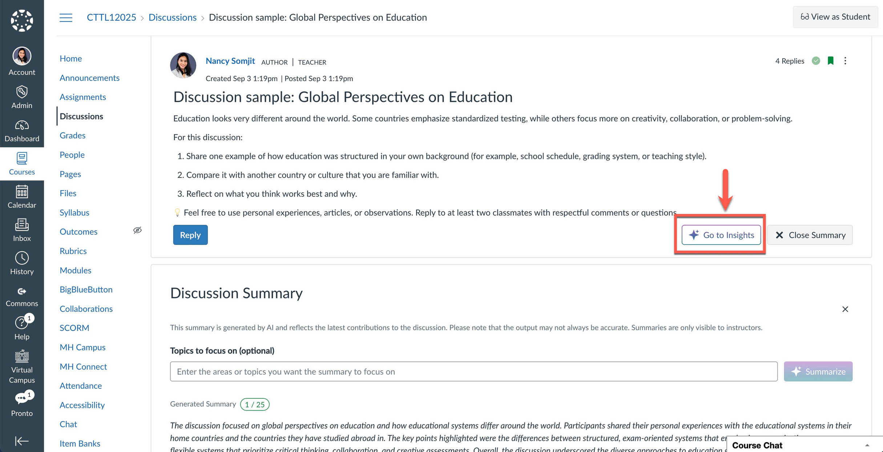

Slide 17
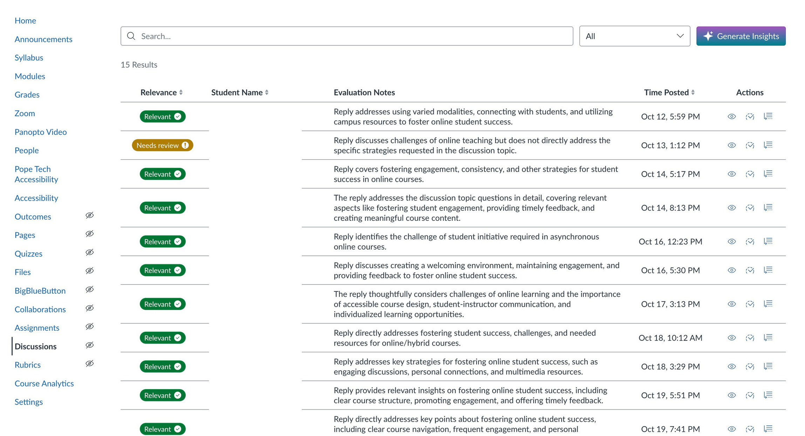

Slide 18
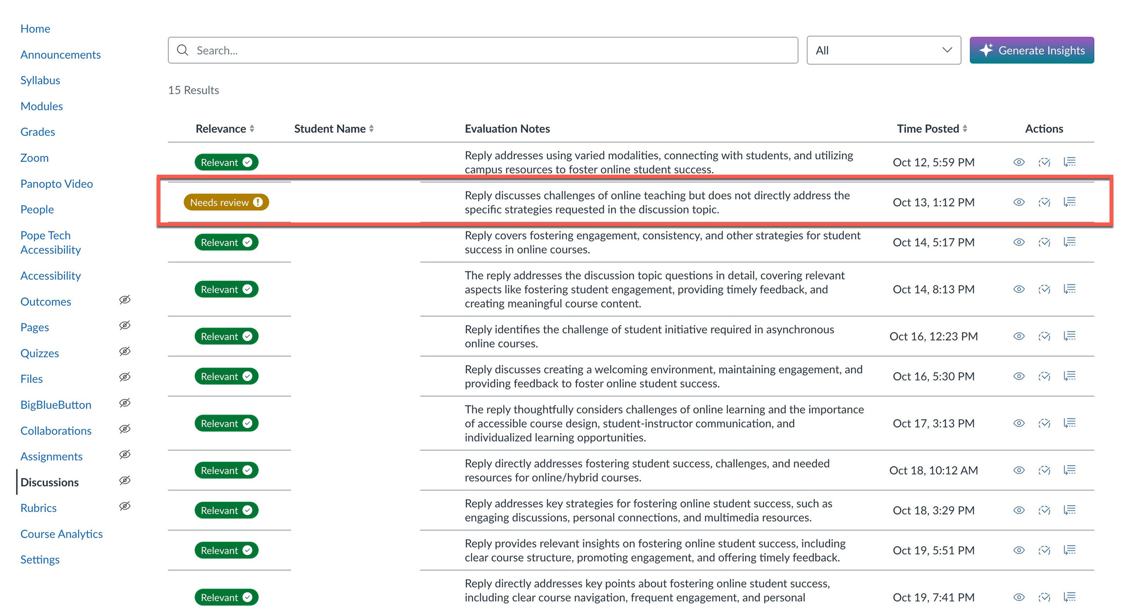

Slide 19
AI
Features
3
Rubrics

Slide 20
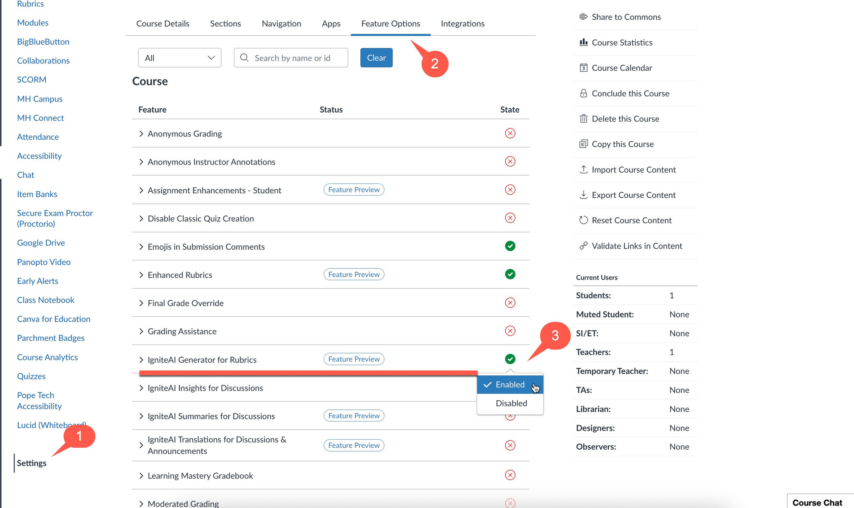

Slide 21
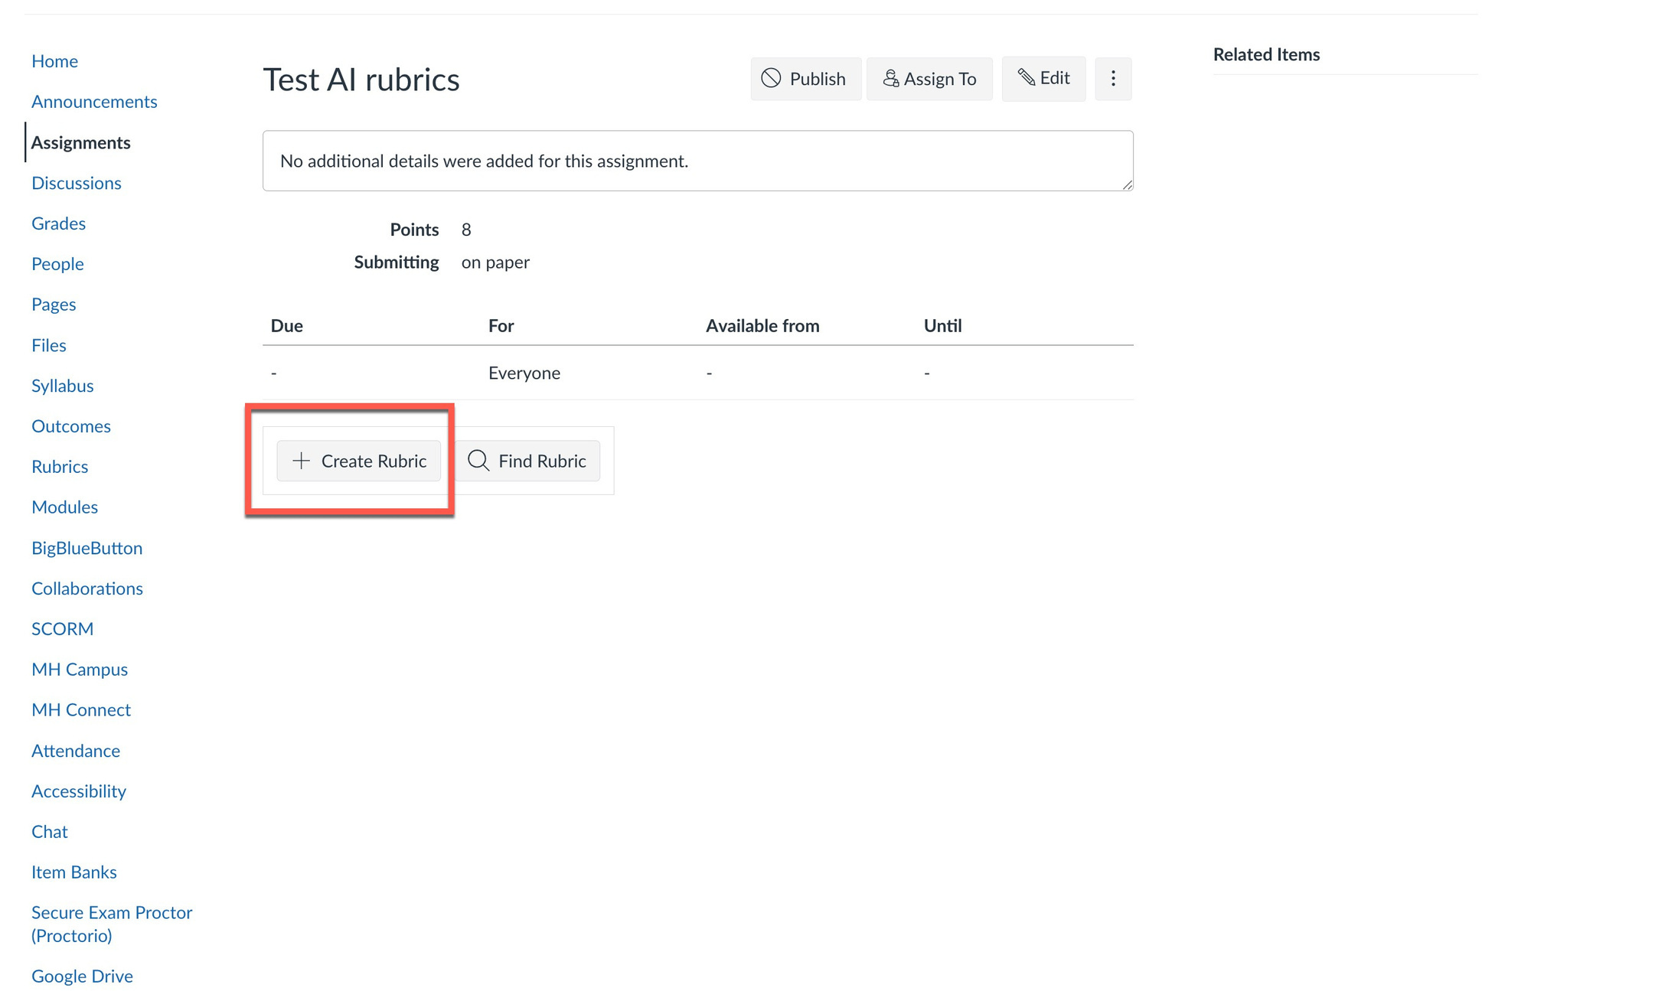

Slide 22
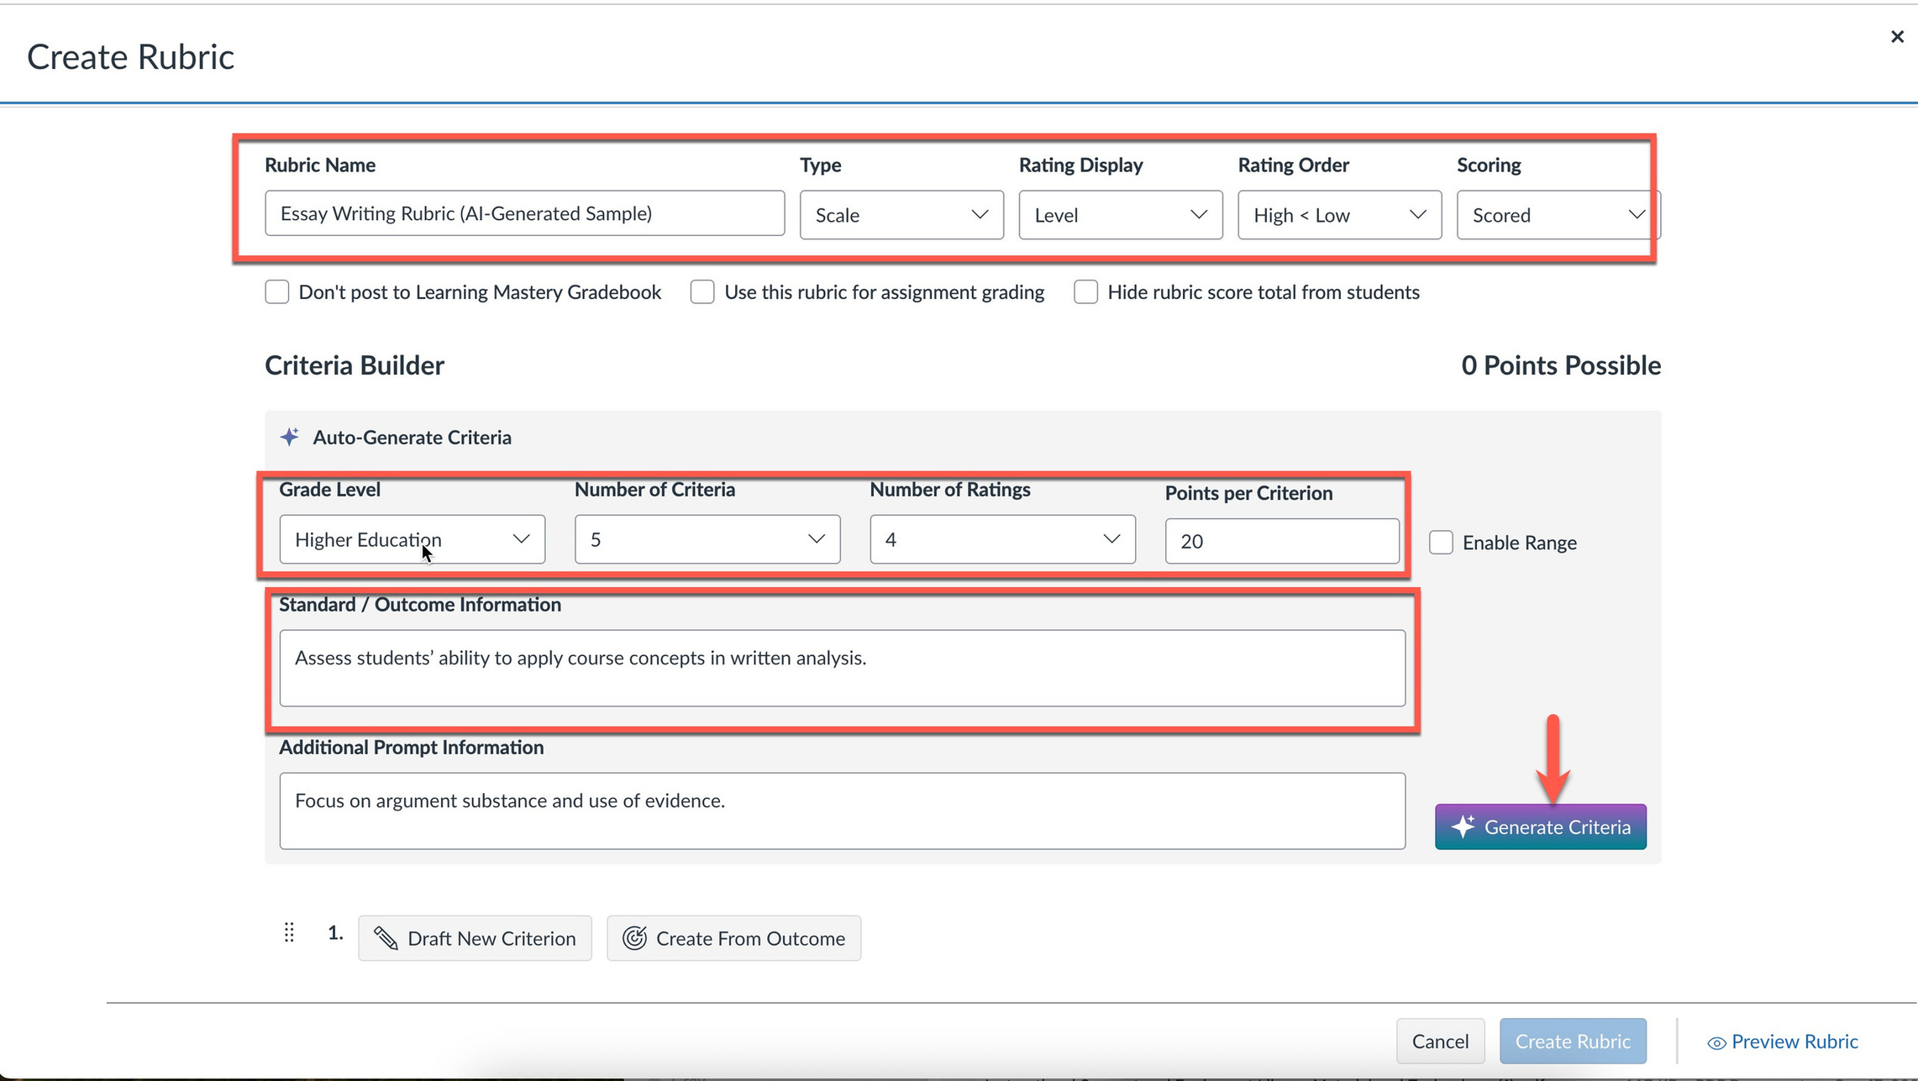

Slide 23
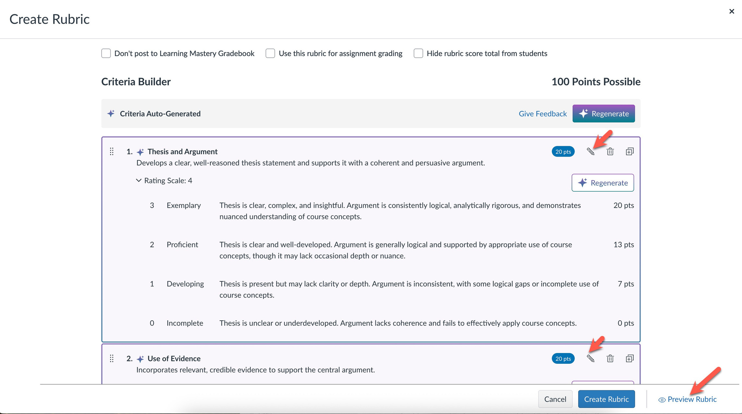

Slide 24
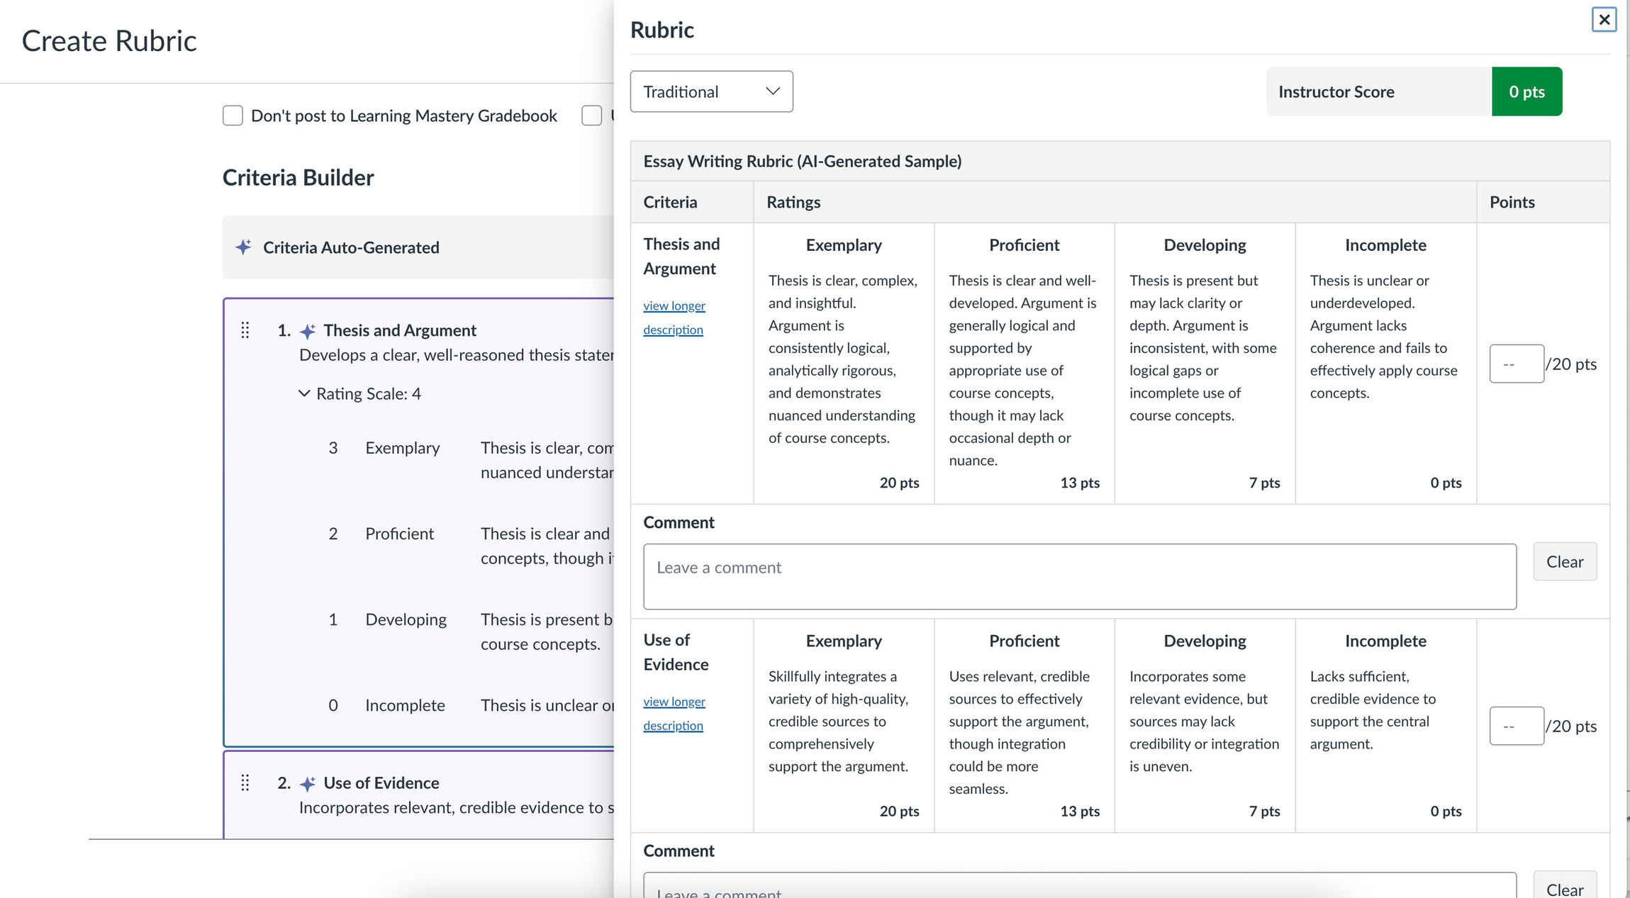

Slide 25
AI
Features
4
Smart Search

Slide 26
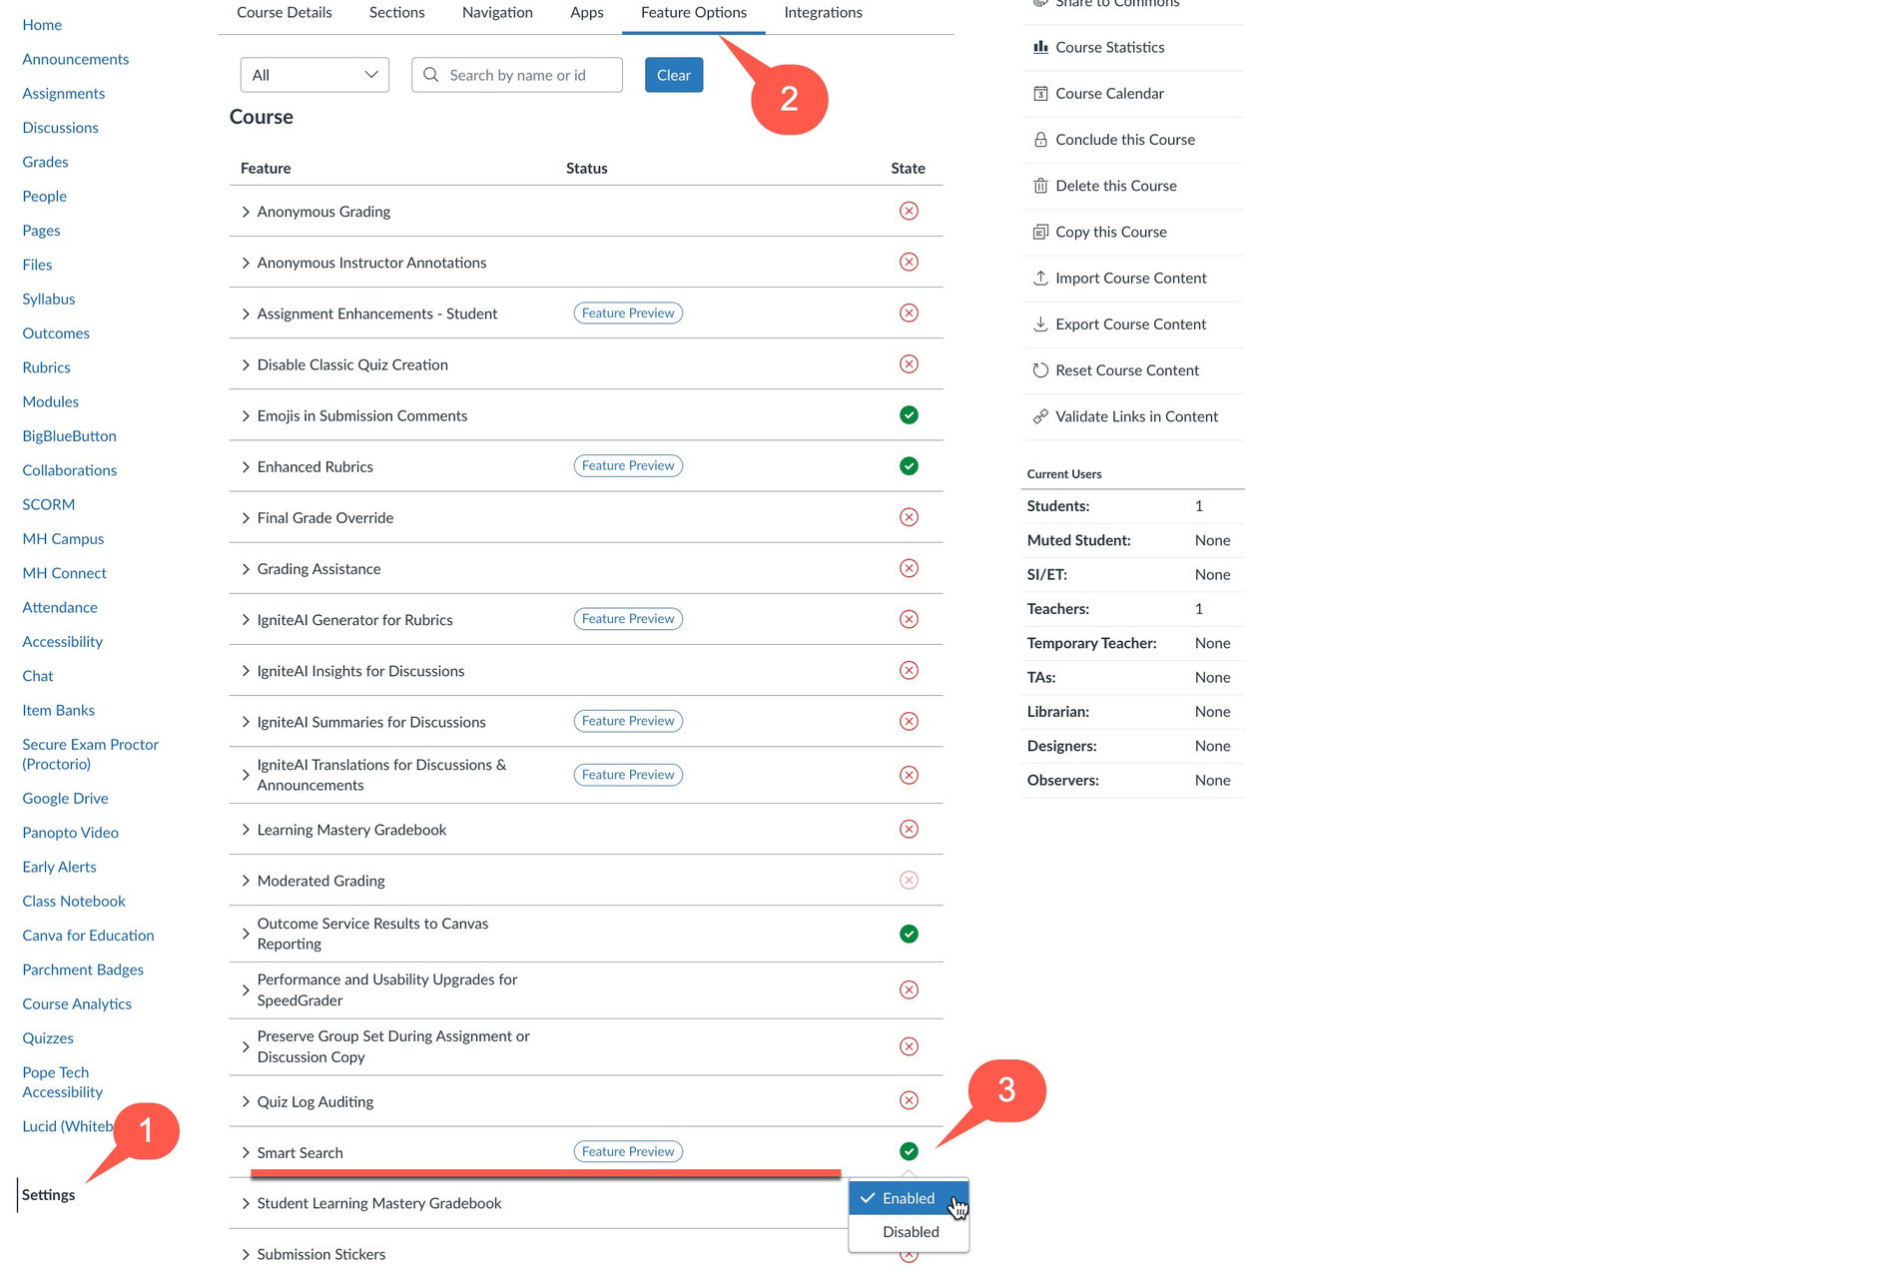

Slide 27
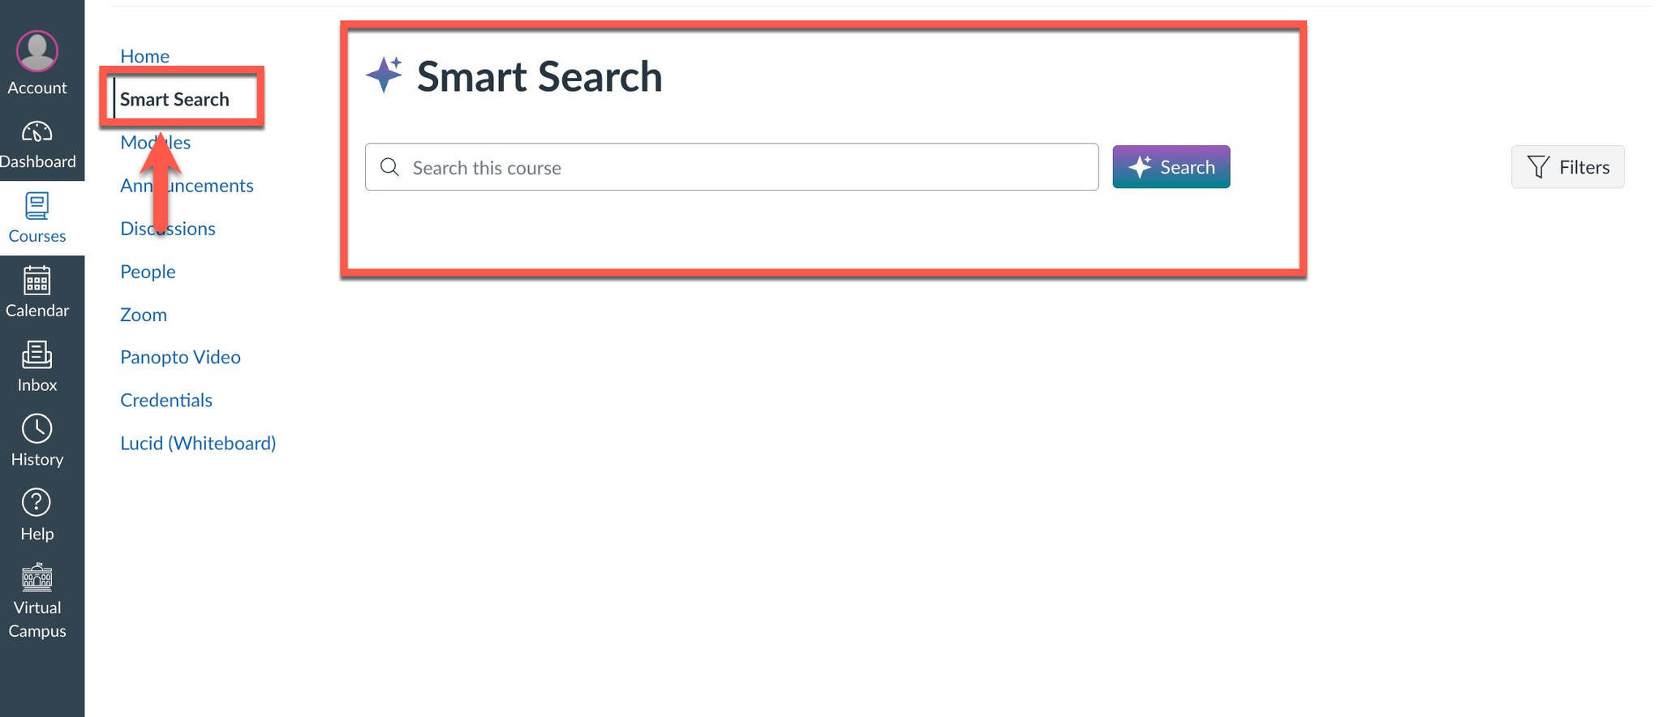

Slide 28
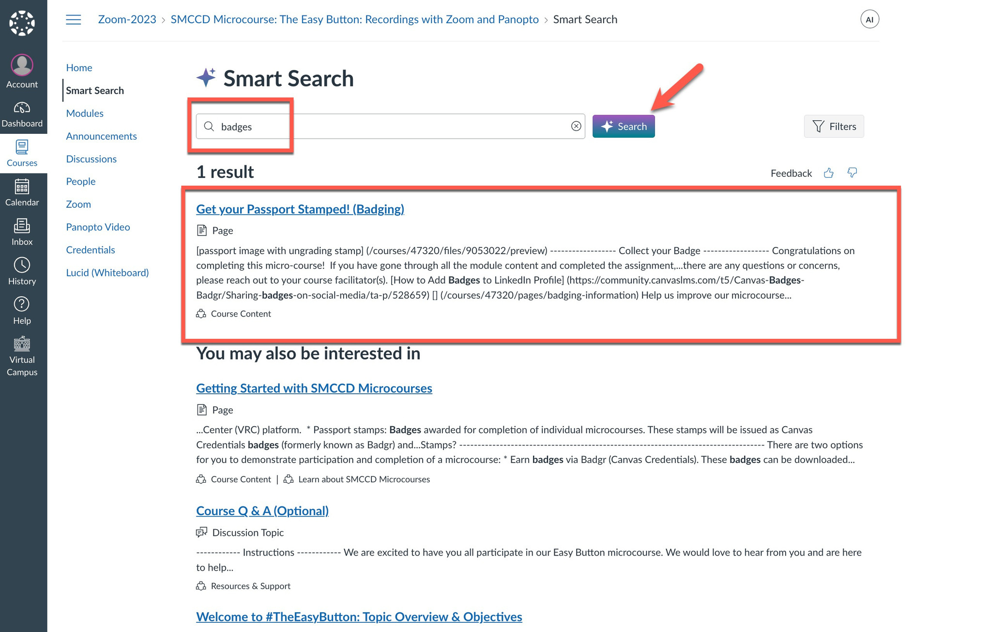

Slide 29


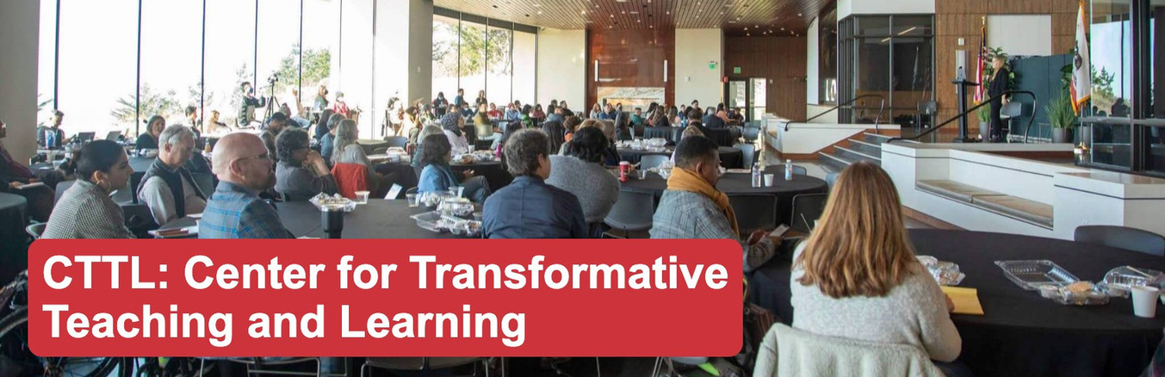

THANK YOU!
Contact: Nancy Somjit ( Somjitp@smccd.edu)

