Slide 1
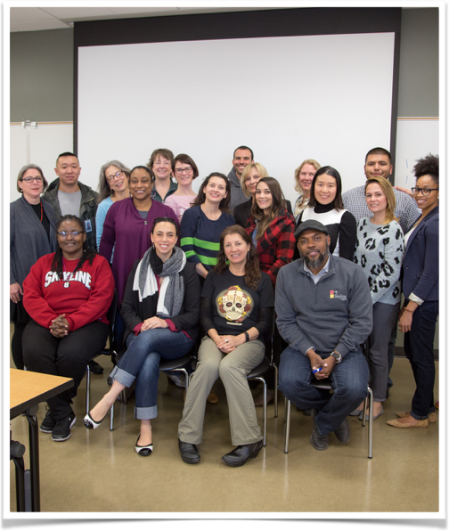
Student Equity and Support Programs Initiatives
Brothers Achieving Milestones
Equity Summit at Skyline College
Equity Training Series
Beyond the Margins Equity Forums
Call to Consciousness College Lecture Series

